Slide 1

Framework for NLP-Driven Insights into Patient-Centered Communication in Oncology Grace Donovan MSDE/MSDS Practicum 1 Regis University, Denver CO June 26, 2025
Notes:
Hi everyone, my name is Grace Donovan.
Today, I’ll be presenting on a framework that I’ve been working on over the past 7 weeks to extract patient-centered communication themes from oncology literature, to shed light on the impact of effective, patient-focused dialogue in healthcare.

Slide 2

Overview
Introduction: Background, Objective, and Key Questions
Framework overview: Data Retrieval, Data Processing, and Data Analysis
Conclusion: Insights, Future Improvements
Notes:
Here’s an overview of my presentation:
First, I’ll discuss a bit of background that relates to my motivation for this project. I’ll also review the project objective and key questions that were used to frame the project.
Then I’ll walk through the framework overview and break down my methodology across the frameworks three core components.
And I’ll finish my presentation with some insights that I was able to derive from this work and discuss future opportunities and improvements

Slide 3
Background
“Effective communication is a cornerstone of quality healthcare. Communication helps providers bond with patients, forming therapeutic relationships that benefit patient-centered outcomes.”
- Samer H. Sharkiya (2023)
1
Patient-focused communication is vital - driving treatment adherence, boosting satisfaction, and improving health outcomes (Sharkiya (2023), Krist et al. (2017), Becker, C., et al. (2021)).
Patient-Centered Care
2
Research Challenges
3
Synthesizing evolving communication practices and associated attitudes from the rapidly expanding medical literature can be difficult, complicating efforts to uphold high-quality patient care (Links, M., et al. (2020)).
Automated Insights
Automation of literature harvesting and analysis, can provide clinicians, researchers, and policymakers with real-time, data-driven decision support (van Dinter, R., et al. (2021)).
Notes:
Patient-centered communication is a critical driver of positive health outcomes, influencing patient satisfaction, patient commitment tor adherence to things like taking medications or following care plans, and overall quality of care.
Yet, the healthcare literature is saturated with diverse theoretical frameworks and communication models, which makes it challenging to consolidate best practices and develop unified, effective approaches.
To address this complexity, automated methods for synthesizing insights from the growing body of patient-centered communication research can play a transformative role. By distilling vast textual data into accessible, evidence-based themes, automated methods can empower clinicians, researchers, and policymakers to make informed, data-driven decisions that enhance patient engagement and care delivery.

Slide 4

Objective
Exploring patient-centered communication themes in peer-reviewed oncology literature
Key Questions
1. Which patient-centered communication topics emerge most prevalent in oncology research?
2. How does author sentiment vary across these topics?
Develop framework using open-source tools to automate the synthesis and analysis of literature in an evolving research landscape
Topical Focus
Notes:
For this project, I set out to build a framework using open-source tools that could automate the synthesis and analysis of key topics in communication and oncology literature
Given the seven-week timeline for this project, I initially needed to clearly define and scope the project. I chose a topic that I’m interested in and wanted to learn more about , which is focused on exploring patient-centered communication themes in peer-reviewed oncology literature.
To guide the framework’s design and ensure a focused approach, I developed two key research questions that anchored each stage of the framework development.

Slide 5

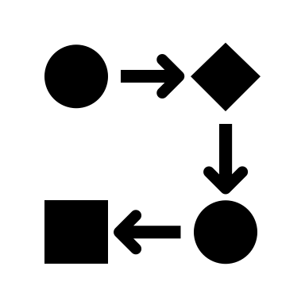

Framework Overview
1. Data Retrieval
Publication full-text data scraping
2. Data Processing
Cleaning, standardizing, sub-setting, and transforming scraped HTML data to JSON dictionary
Preprocessing cleaned text data for analysis (stop word removal, POS tagging, lemmatization, etc.)
3. Data Analysis
Exploratory data analysis using word frequency distributions and n-grams
Aggregating topic modeling for theme identification and sentiment analysis for sentiment classification of identified themes
Related publication identification
Notes:
The framework that I created, consists of three core components, which I’ll walk through in more detail in the following slides:
But to give you a quick overview:
Component 1, Data Retrieval, which entailed sourcing relevant communication in oncology literature.
Component 2, Data Processing, which involved cleaning and preparing publication text data for analysis.
And Component 3, Data Analysis, which entailed extracting and interpreting key communication themes in the literature

Slide 6
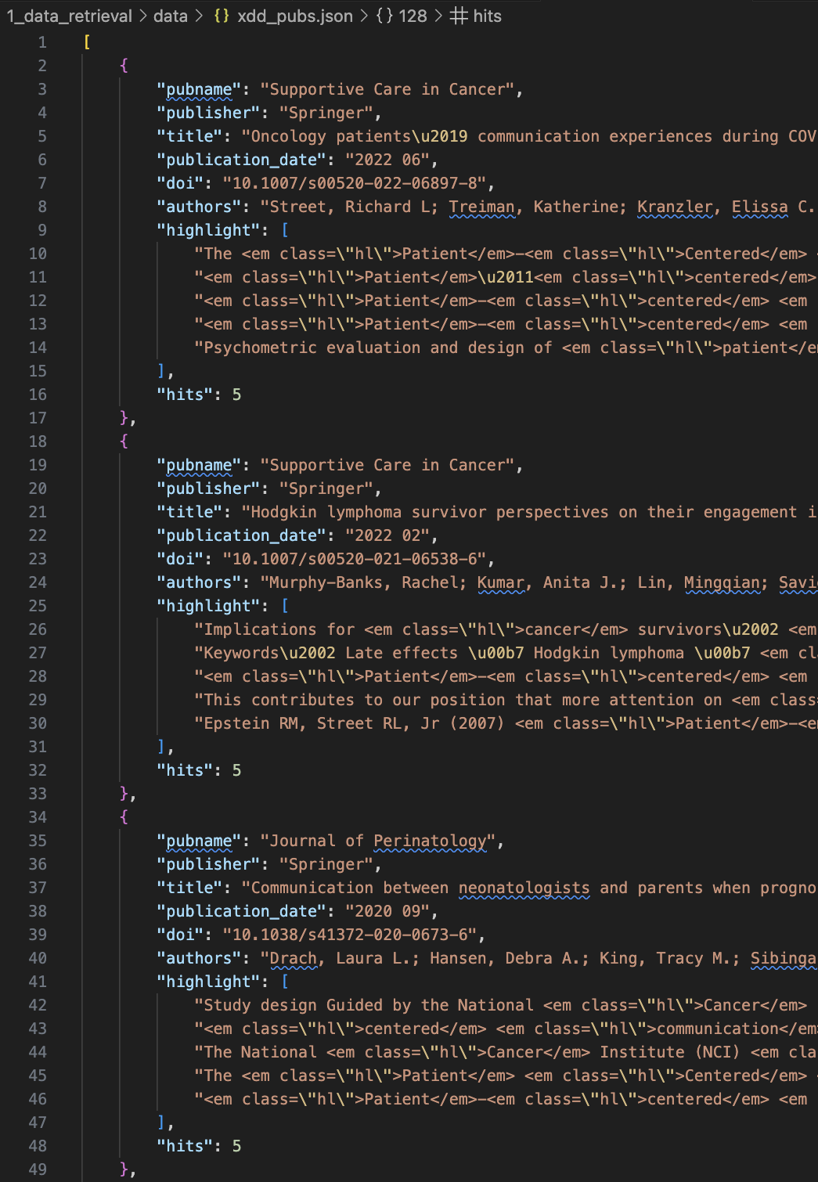
Related Publication Identification and Initial Retrieval using xDD API Component 1 – Data Retrieval
What is xDD?
A cyberinfrastructure that compiles data on published literature and provides users with the ability to perform full text searches of published literature through the xDD API (Peters et al. 2025).
Workflow:
Keyword Query: publications containing both “patient-centered communication” and “cancer” keywords
Filter: articles with ≥ 2 total keyword hits, published between 2020 and 2025.
Extracted Fields: Publication name, publisher name, title, date, DOI (Digital Object Identifier), author names, text snippets (“highlights”) where keywords appeared, and count of keyword occurrences per document
Output: Consolidated 130 publication metadata entries into a single JSON file for downstream analysis or visualization.
Notes:
I started off by using the xDD API to identify publications on patient-centered communication and cancer.
xDD is a cyberinfrastructure that compiles data on published literature and provides users with the ability to perform full text searches using the xDD API.
Workflow:
I queried the xDD corpus for publications containing both “patient-centered communication” and “cancer” keywords
I also set several filtering parameters. For example,
The xDD API includes a module that returns snippets of publication text that include specified keywords, along with the number of “hits” or occurrences of the keywords within the publication. I chose to filter my query to only include publications with 2 or more hits containing both keywords to ensure that I was retrieving relevant publications.
I also set a date filter to retrieve articles published between 2020 and 2025.
My filtered query returned publication metadata, like DOI, title, author names, and publisher information.
From there, I extracted and saved the metadata fields that I thought would be most relevant to my project, including publication name, publisher name, publication title, publication date, digital object identifier (DOI), author names, list of highlights or snippets of the full text publication where the keywords were identified, and the number of hits.
Ultimately I was able to retrieve 130 publication metadata entries using the xDD API.

Slide 7
Full-text Data Scraping of Related Publication Webpages Component 1 – Data Retrieval
Constructed publication DOI URLs from DOI identifiers collected from xDD API
Used Selenium WebDriver and BeautifulSoup for scraping full-text from publication webpages
Specific sections targeted for scraping (abstract, methods, results, conclusion, etc.)
Filters included for handling inconsistencies and scraping issues
89 publications successfully scraped and saved as HTML files
Notes:
From there, I began the process of trying to collect the full-text data for each publication.
First, I constructed DOI URLs for each related publication using the xDD publication metadata that I collected in the step I mentioned in the last slide
Then, I used Selenium WebDriver and BeautifulSoup to scrape the full-text sections of the publication webpages that were saved an individual html files.
I added filters to my scripts to scrape specific sections from each publication page, including the abstract, introduction, methods, results, conclusion sections, and more.
I ran into a few hurdles with this step related to some publishers blocking access to the full text of their publications, duplicate section headers that introduced parsing issues, and inconsistent page structures across journals that made scraping the text data difficult.
There were 41 publications that I was not able to scrape and I also identified 1 conference proceeding that I chose exclude from the final output.
But I was able to scrape sections of full text data for 89 publications

Slide 8
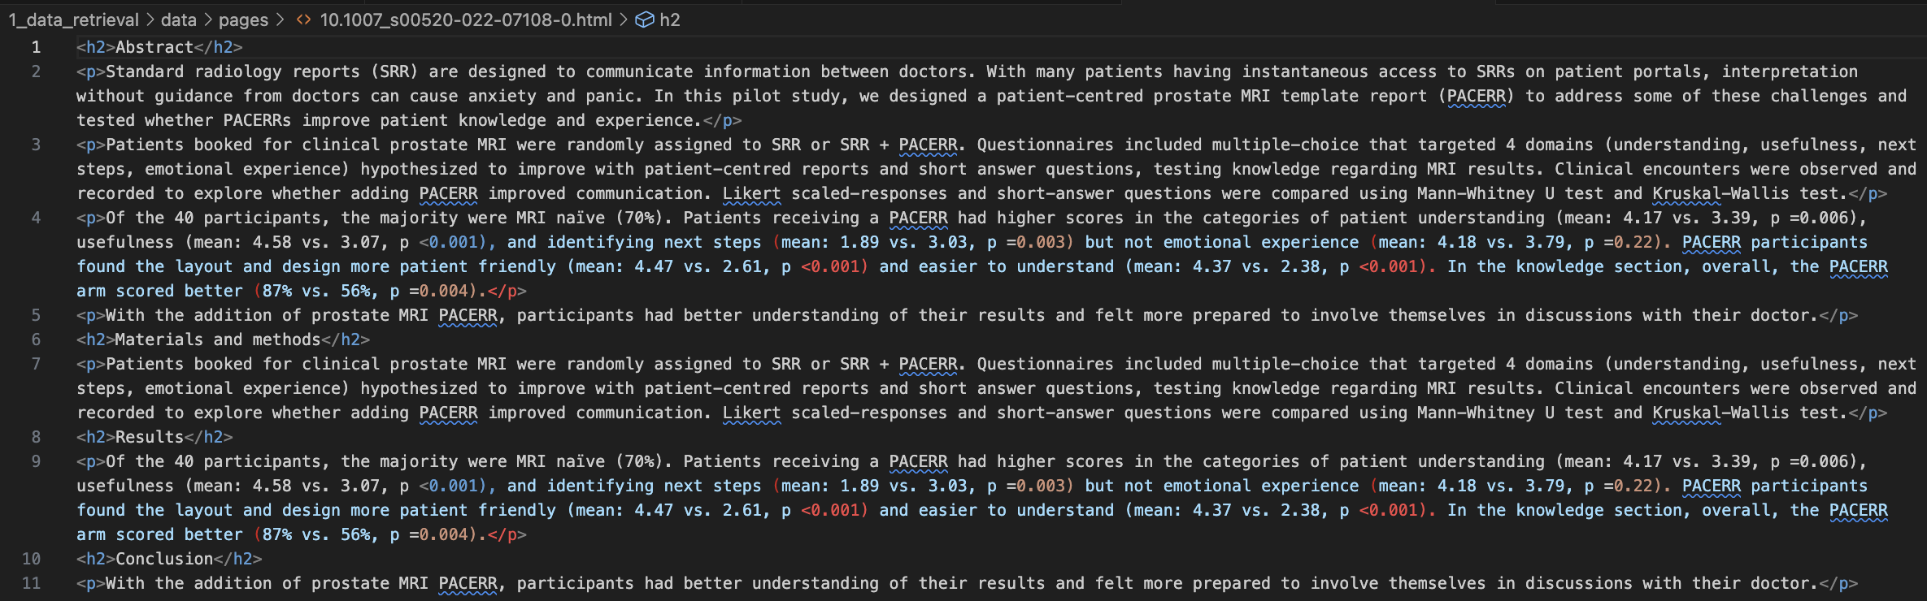
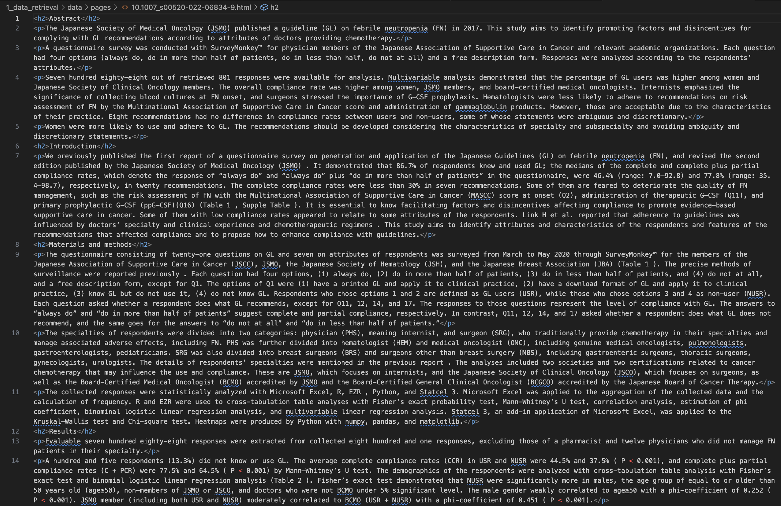
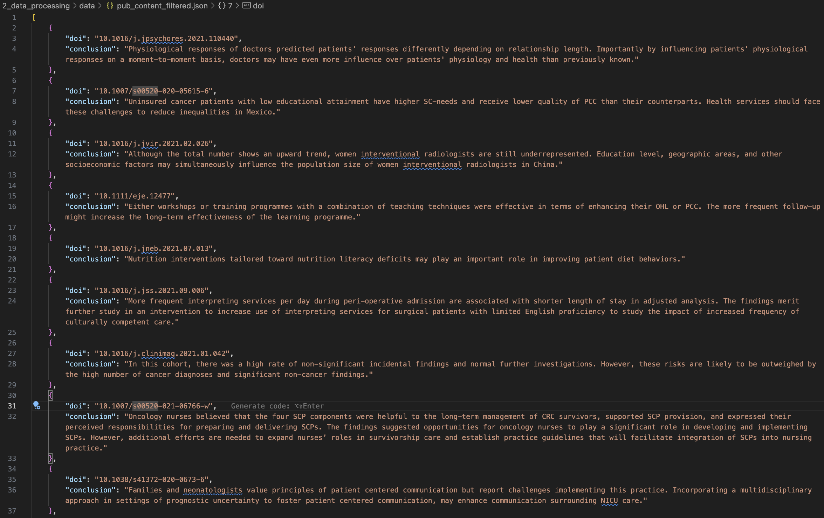
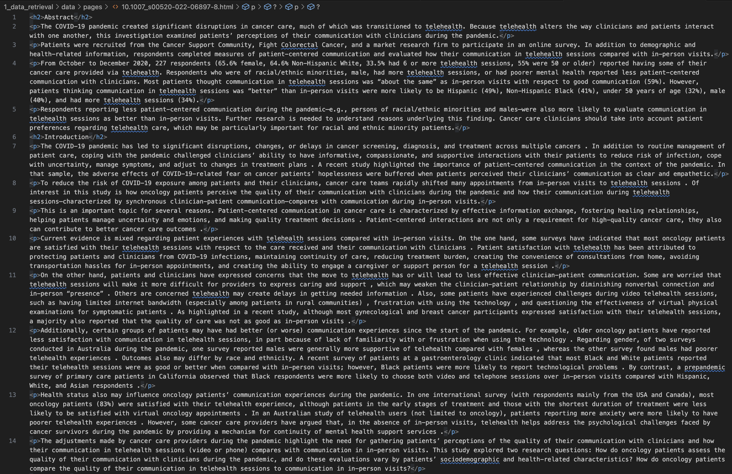
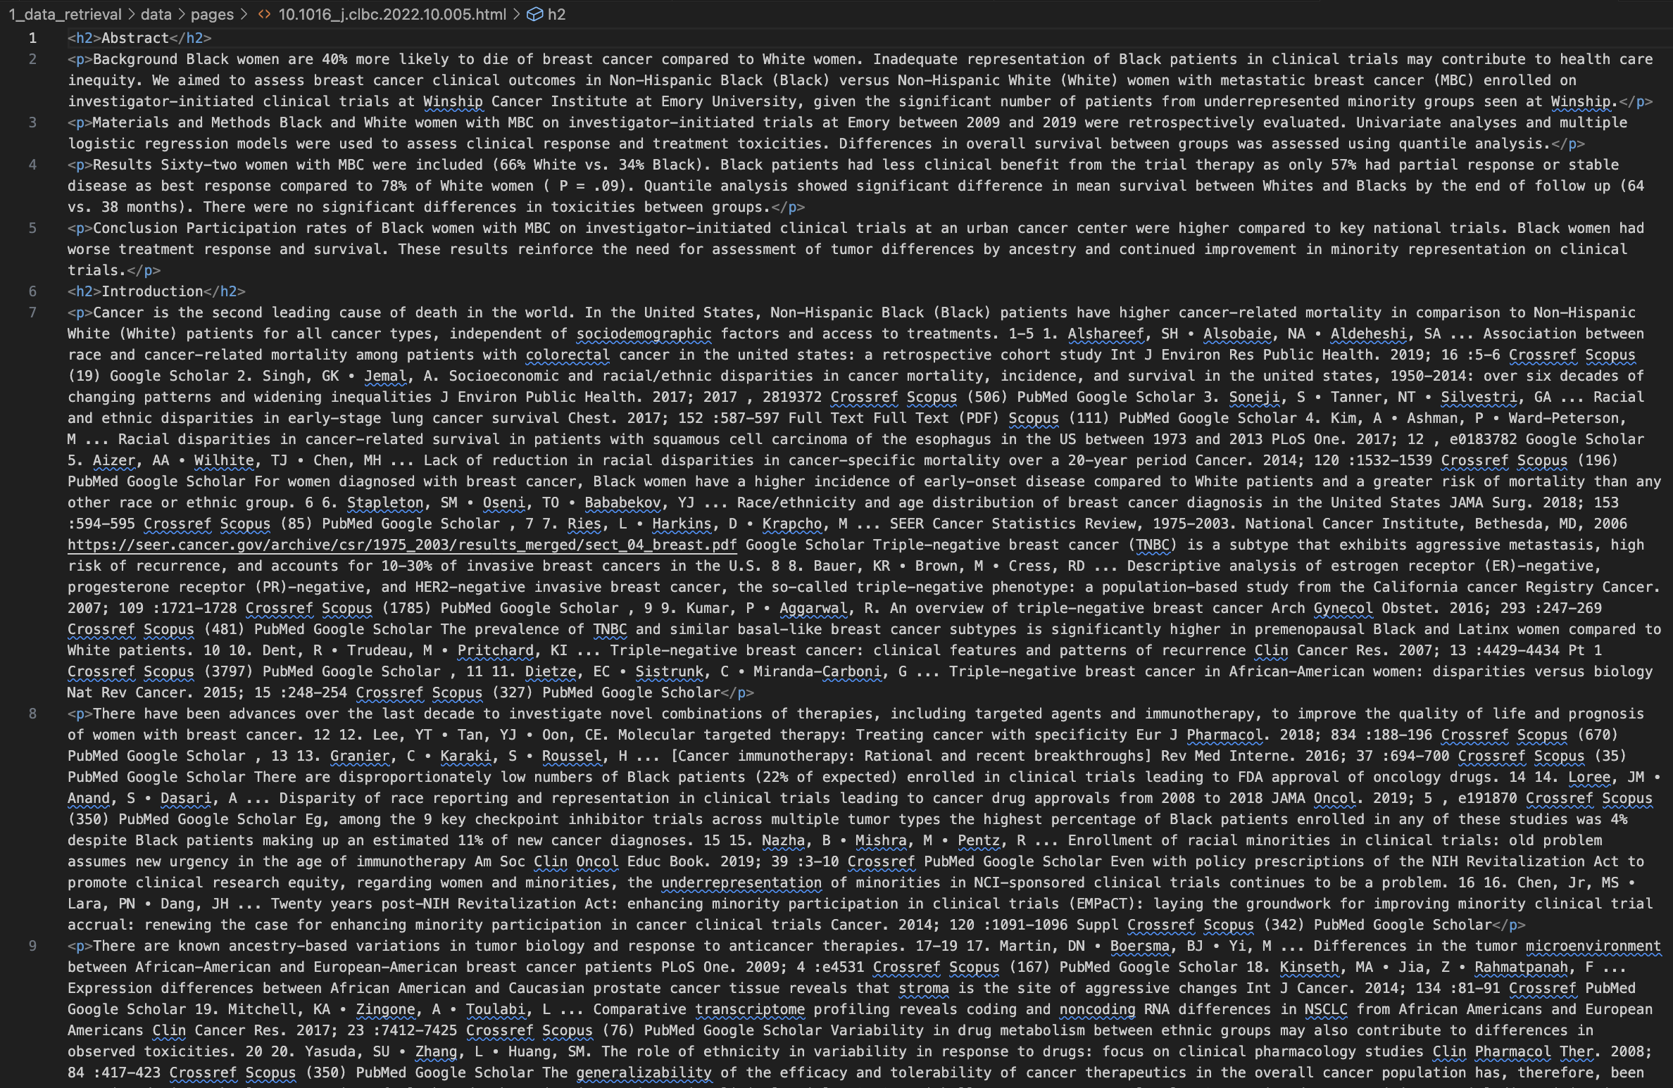
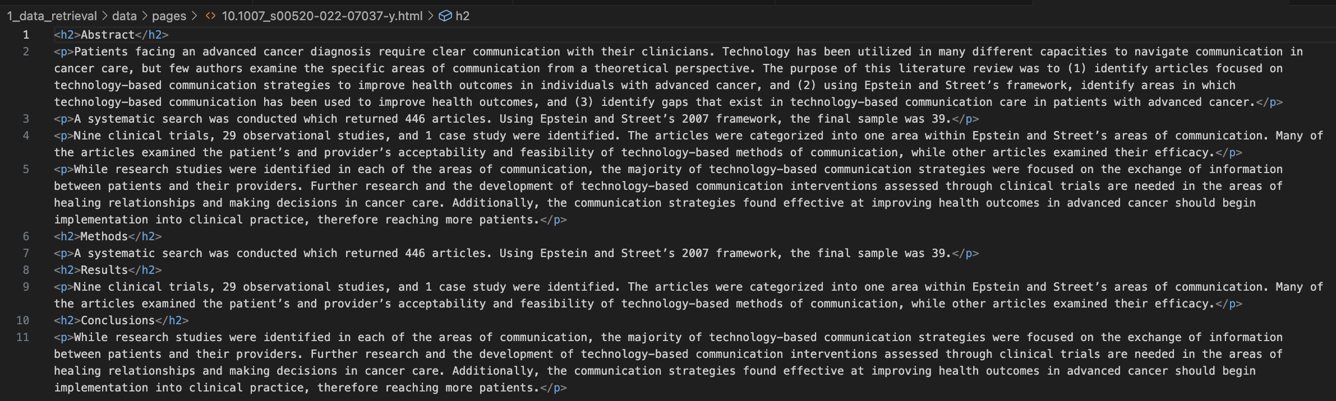
HTML Content Extraction and Cleanup Component 2 – Data Processing
89 HTML Files
(Raw Text Data)
1 JSON File
(Standardized, Cleaned, and
Formatted Text Data)
Notes:
Next, I moved into the data-processing phase, where I cleaned up the raw HTML into a structured and refined dataset
I started off by parsing the HTML files to extract the header and paragraph HTML tag pairs.
Because some publication websites provided the full-text while others, often paywalled, only showed abstracts, there was a lot of variation in terms of the sections that I was able to scrape.
There was also variation in how sections were labeled across publications. For example, some publications listed the sections differently than others or lumped sections like methods and results together instead of including them as distinct sections.
To account for all of these variances and to make my life easier, I standardized certain section labels. This entailed renaming sections, for example updating the ‘summary’ section label to ‘abstract’.
From there, I cleaned the data by stripping all in-text citations, trimming whitespace, and fixing mis-encoded characters.
I also decided to subset the 89 publications so that the output would only include scraped publication data with conclusion sections.
By the end of this process, the output file included conclusion sections and DOIs for 43 publications.

Slide 9

Preprocessing Conclusion Data for Analysis Component 2 – Data Processing
Process:
Tokenization: Sentence → word level
Lowercasing: Normalize to lowercase
Stop word removal: stop words + domain-specific terms
Length filtering: Remove words <3 characters
POS filtering: Remove adverbs (less contextually relevant)
Lemmatization: Reduce words to root forms
Notes:
Next, to get the conclusion text data ready for analysis, I ran a second, more focused round of text cleaning:
I started by tokenizing the text and transforming each word to lowercase in order to maintain consistency
Then I stripped out standard stop words plus domain-specific words like database and repository names, including Crossref, and pubmed.
I filtered out all tokens with less than three characters to weed out stray acronyms.
I also applied POS tagging and removed all adverbs, sharpening the dataset around the most meaningful terms.
Finally, I lemmatized each word reducing it to its root form, to ensure core concepts would be captured in the data analysis phase.

Slide 10
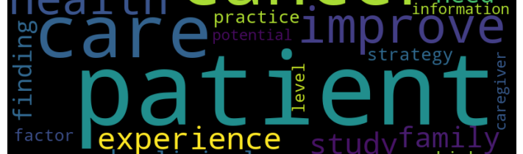
Exploratory Data Analysis Component 3 – Data Analysis
Word Frequency Analysis
Top terms: patient (54), care (25), cancer (24), communication (22)
"Patient" occurrence confirmed research focus alignment
N-gram Pattern Dcanceriscovery
Bigrams: ”cancer patient" (5), "cancer care" (4), ”family caregiver" (4), “lung cancer” (4), “health information” (3)
Trigrams: ”health information platform" (2), ”cancer communication guideline" (2), ”patient support person" (2), “positive health outcome” (2), “experience racial discrimination” (2)
"Patient" occurrence confirmed research focus alignment
Notes:
For the Data Analysis (or EDA) portion of this project, I began with a simple exploratory data analysis to look at word frequency distributions and top n-grams.
Some of what I initially saw from the EDA results helped me refine the preprocessing step I described in the last slide. For example, I found a lot of occurrences of database and repository names and file extension names that I decided to remove because I didn’t think they would provide relevant information in this last step of the project. So I used the EDA to refine how the data was preprocessed.
I also discovered some interesting initial insights into the dataset during this step.
One thing that I noticed from the top words and n-grams is that the word “patient” was included the most across the word frequency distribution and n-grams.
This helped me confirm the research focus alignment between the publication conclusions that I collected and my key questions and topical focus for this project

Slide 11
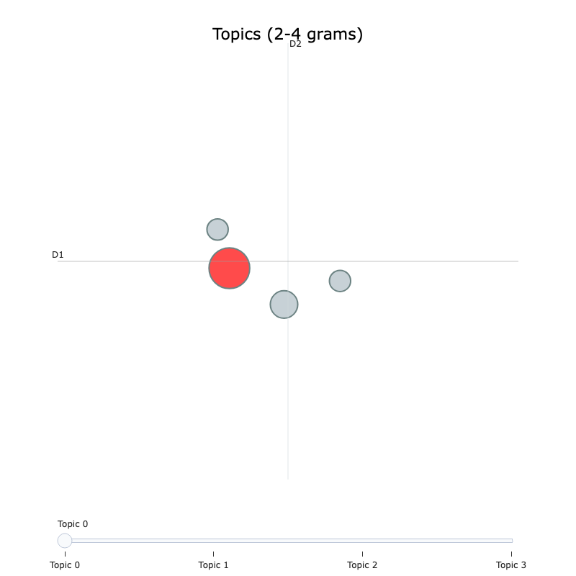
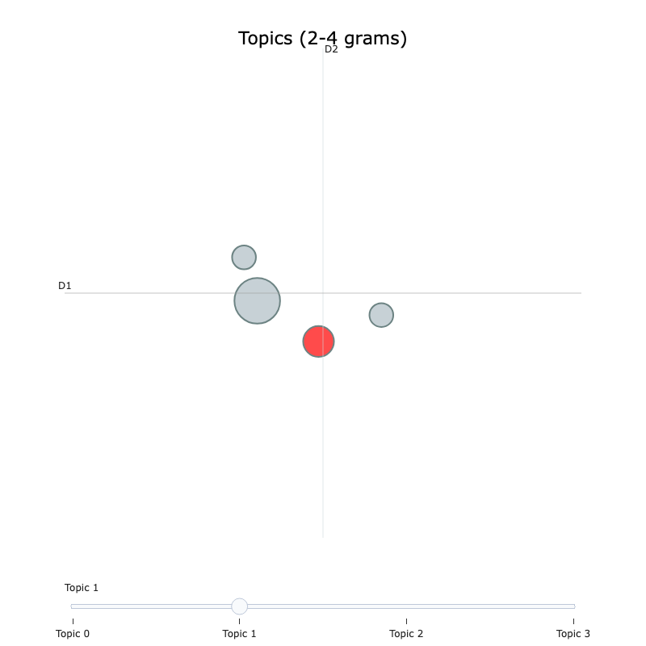
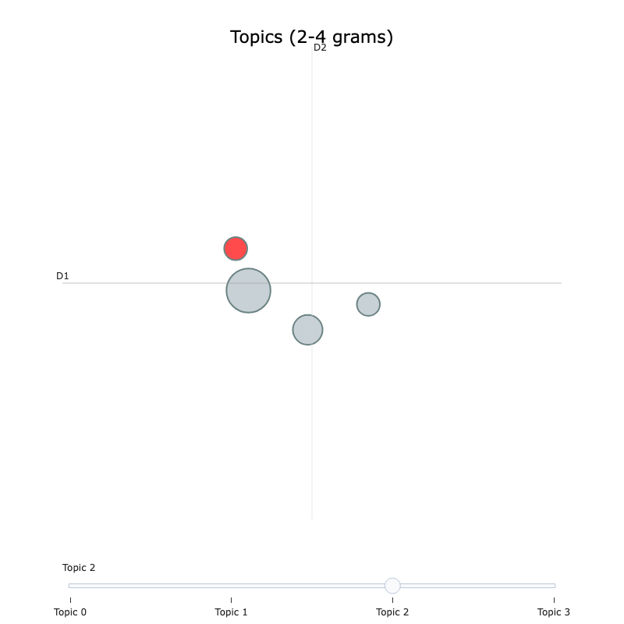
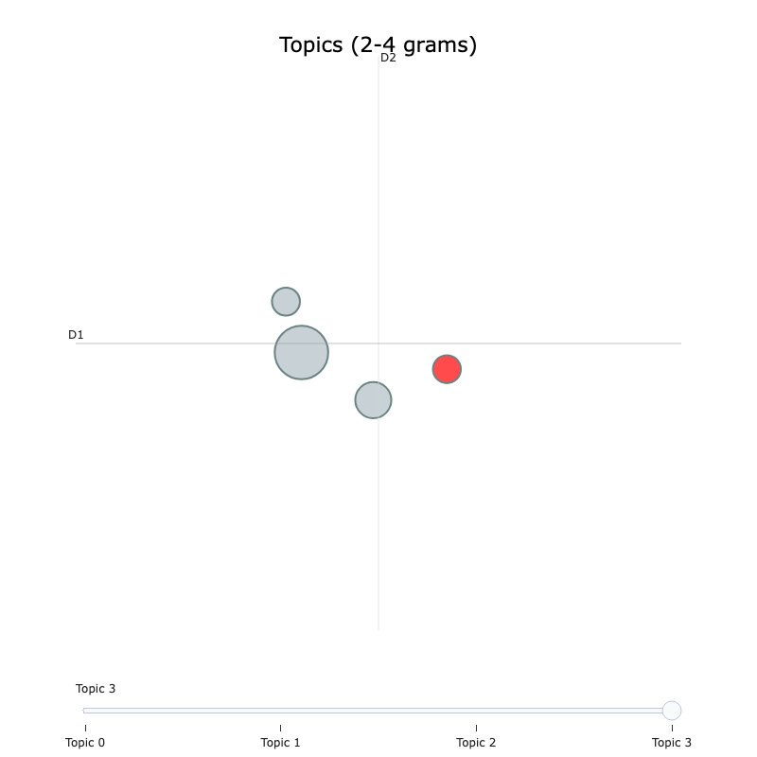
Topic Modeling Implementation Component 3- Data Analysis
BERTopic Clustering:
Multi-word theme extraction using n-grams (2-4 word phrases)
UMAP dimensional reduction for semantic clustering
HDBSCAN density-based topic formation
Minimum cluster size: 3 documents (coherent topics)
Notes:
Next, I transitioned to applying a topic model to extract tge key themes discussed in the publication conclusions.
At first, I used Gensium’s LDA model and then I transitioned to using BERTopic clustering.
I tuned the BERTopic model parameters and found that multi-word theme extraction, using n-grams, provided more value insights compared with the single word theme extraction.

Slide 12
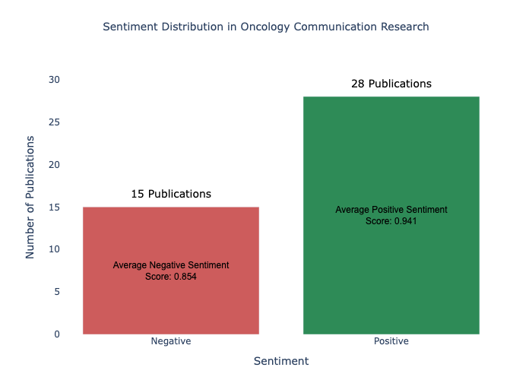
Sentiment Analysis Component 3 - Data Analysis
DistilBERT model (distilbert-base-uncased-finetuned-sst-2-english) applied to publication conclusions
Predominantly positive sentiment identified, revealing research community attitudes toward interventions
Notes:
Next, I applied a DistilBERT-based sentiment model to each publication conclusion, classifying each as positive or negative.
I then used the sentiment values to map the tone across each of the publication conclusions included in my oncology corpus.
Of the 43 publication conclusions, the model identified 26 (63%) as positive, revealing what I thought was a generally optimistic tone across the communication and oncology corpus.

Slide 13
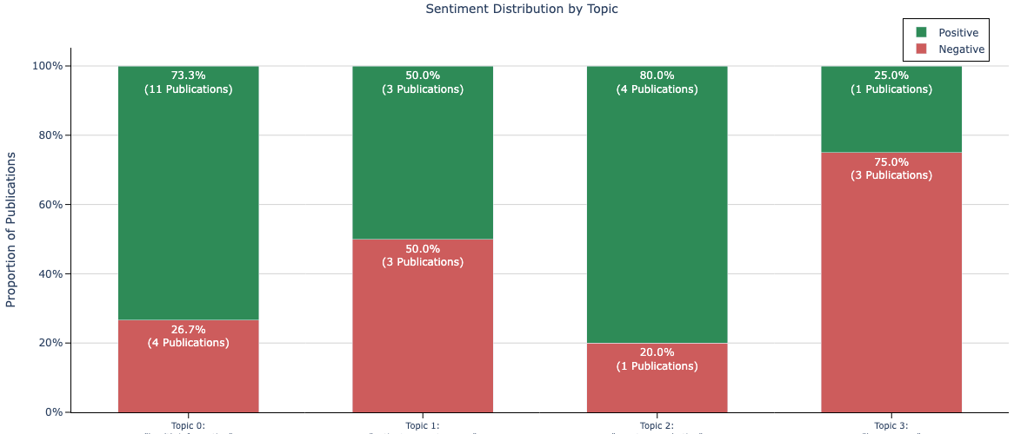

Aggregation of Topic-level Sentiment Distribution Analysis Component 3 - Data Analysis
Notes:
To answer my research questions, I fed the sentiment-annotated conclusions into the bigram and trigram topic model, combining thematic clustering with sentiment scores to uncover how key topics aligned with emotional tone.
By integrating the two methods, I uncovered richer, more nuanced patterns than either method alone could reveal.
This stacked bar chart shows, for each topic, the proportion of publications with positive versus negative sentiment, highlighting which topics the publications are grouped within.

Slide 14
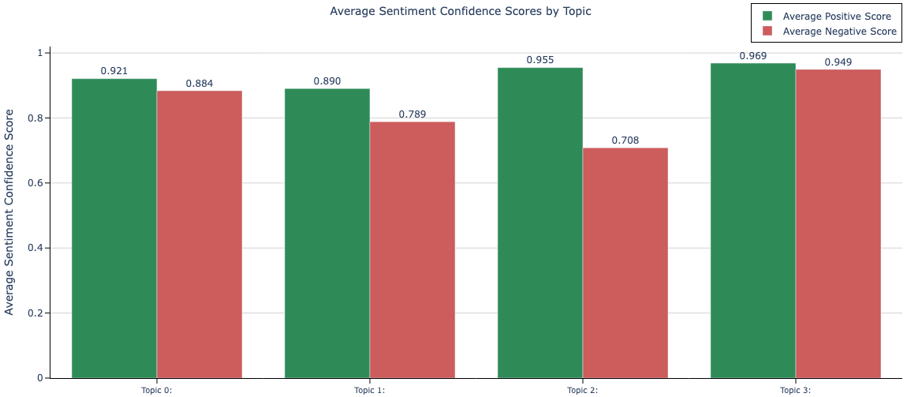
Aggregation of Topic-level Sentiment Distribution Analysis Component 3 - Data Analysis
Topic 0 Top Keywords:
“health information”
“secure message”
”improve patient”
“oncology nurse”
Topic 1 Top Keywords:
“patient support person”
“cancer survivor”
“support person”
“experience racial discrimination”
Topic 2 Top Keywords:
“onset exacerbation”
“therapeutic burden”
“patient crpc”
“drug product”
Topic 3 Top Keywords:
“lung cancer”
“acute traumatic”
“radiotherapy advance”
“mitigate risk adverse”
Notes:
I then calculated each topic’s average positive and negative confidence scores—not just to tally how many documents lean one way, but to measure how strongly they lean positive or negative on average.
This comparative plot shows all of the topics all hit roughly the same positive and negative average confidence score, indicating a genuinely mixed tone of both enthusiasm paired with equally strong caution or concern.
Those dual-high scores might reflect real ambivalence in the literature or could signal overconfidence in the sentiment model. To dig deeper, I’d plot individual document scores, compute net sentiment (positive minus negative), or even run a qualitative spot check.
On the left, I’ve listed each topic’s top three keywords so you can see how these themes map back to the focus of this project on patient-centered oncology communication.

Slide 15


Project Insights and Lessons Learned
xDD streamlines discovery of related studies and automates retrieval of publication metadata
Capturing full-text articles remains challenging, due to publisher paywalls and inconsistent website structures
Multi-word extraction more effectively captured relevant terms
A combined topic modeling and sentiment analysis approach revealed both optimistic and cautionary tones in key themes
Future Improvements
Performance & Monitoring: Refined and async scraping
Model & Research: Recalibrate models, add temporal, cancer-type, and outcome analyses, and analyze more publication content (other than conclusions).
Deployment: Migrate to a database backend
Notes:
In terms of effective approaches here are some of my main insights:
xDD is a great open-source tool that can help streamline discovery of related literature
Scraping full-text data from publication webpages may always be challenging because of publisher paywalls and variations in website structures
Extracting multi-word phrases uncovered domain-specific nuances that single tokens missed..
A combined approach using topic modeling and sentiment analysis, provided more introspective information on the research community’s attitudes toward core patient-centered communication themes, revealing that optimism and caution or concern coexist.
For lessons learned and future improvements to this work, I would work on a few different things. Including:
I would refine my scraping functions to capture content that I was not able to retrieve. This would including updating the code to collected attached files containing publication information and any highly customized HTML that my scraping implementation missed. I would also implement asynchronous web scraping for faster, more reliable data collection.
If I had more time, I would also spot check and recalibrate the sentiment and topic models used in the analysis to prevent overconfidence.
I think it would also be interesting to dive deeper into more analysis of the data to explore things like how communication themes and sentiment evolve over time, compare communication needs and sentiments across specific cancer subtypes, and analyze more of the publication sections like “abstract” to gain additional insight.
In terms of technical enhancements, I would move away from storing the data in JSON files to a scalable database (NoSQL) for more efficient querying and versioning

Slide 16




Conclusion
Approach
Automated pipeline for literature mining and interpretable outputs
Combined NLP methods (BERTopic, DistilBERT)
Key Findings
Identified dominant themes in patient-centered cancer communication
Detected mixed sentiment toward communication-focused interventions
Research Impact
Offers an evidence-based framework for identifying oncology communication strategies
Has the potential to reveal best practices that can be consolidated into a unified approach
Technical Contribution
Architecture tailored to midsize scientific literature corpora
Modular components could be reused across domains
Notes:
In conclusion, here’s an brief overview again of my practicum project
So I built an end-to-end pipeline that harvested patient centered communication and oncology literature
I combined various natural language processing methods to gain insights into sentiments towards major theme in the data that I collected
What did I find? A handful of core themes related to patient centered communication in oncology and somewhat mixed sentiments related to those themes, which demonstrate optimism and concern. That mixed tone indicates that researchers could be celebrating progress in this field while spotlighting gaps at the same time.
Why does it matter? With these synthesized insights, there’s an evidence-based approach for refining communication strategies in oncology. There’s the potential for clinicians and researchers to use this type of approach to understand effective best practices and incorporate them into training or guidelines, which could ultimately improve patient outcomes.
And finally on the tech side, the pipeline scales to midsize corpora and the components are modular, so the framework could be applied to other topics and reused.

Slide 17
References
Becker, C., et al. Interventions to Improve Communication at Hospital Discharge and Rates of Readmission: A Systematic Review and Meta-analysis. JAMA network open vol. 4,8 e2119346. (2021), https://doi.org/10.1001/jamanetworkopen.2021.19346.
Krist, A.H., et al. “Engaging Patients in Decision-Making and Behavior Change to Promote Prevention.” Studies in health technology and informatics vol. 240 (2017), https://pmc.ncbi.nlm.nih.gov/articles/PMC6996004/.
Links, M.J., et al. Finding common ground: meta-synthesis of communication frameworks found in patient communication, supervision and simulation literature. BMC Med Educ 20, 45 (2020). https://doi.org/10.1186/s12909-019-1922-2.
Peters, S.E., et al. xDD: About. (2025), https://geodeepdive.org/about.html.
Sharkiya, S.H., Quality communication can improve patient-centred health outcomes among older patients: a rapid review. BMC Health Serv Res 23, 886 (2023). https://doi.org/10.1186/s12913-023-09869-8.
van Dinter, R., et al. A decision support system for automating document retrieval and citation screening, Expert Systems with Applications, (2021), https://doi.org/10.1016/j.eswa.2021.115261.
All images and icons used in the presentation were sourced from PowerPoint.

Slide 18
Thank you!

